Slide 1
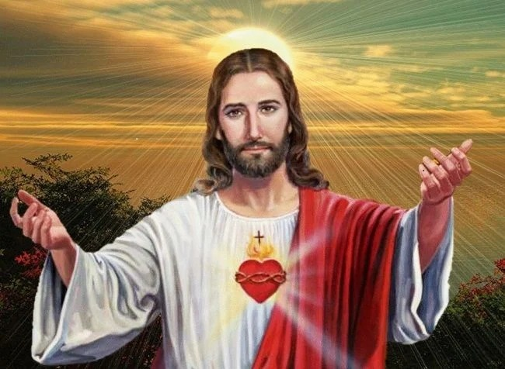
We are one family in Christ

Slide 2
We celebrate His life

Slide 3
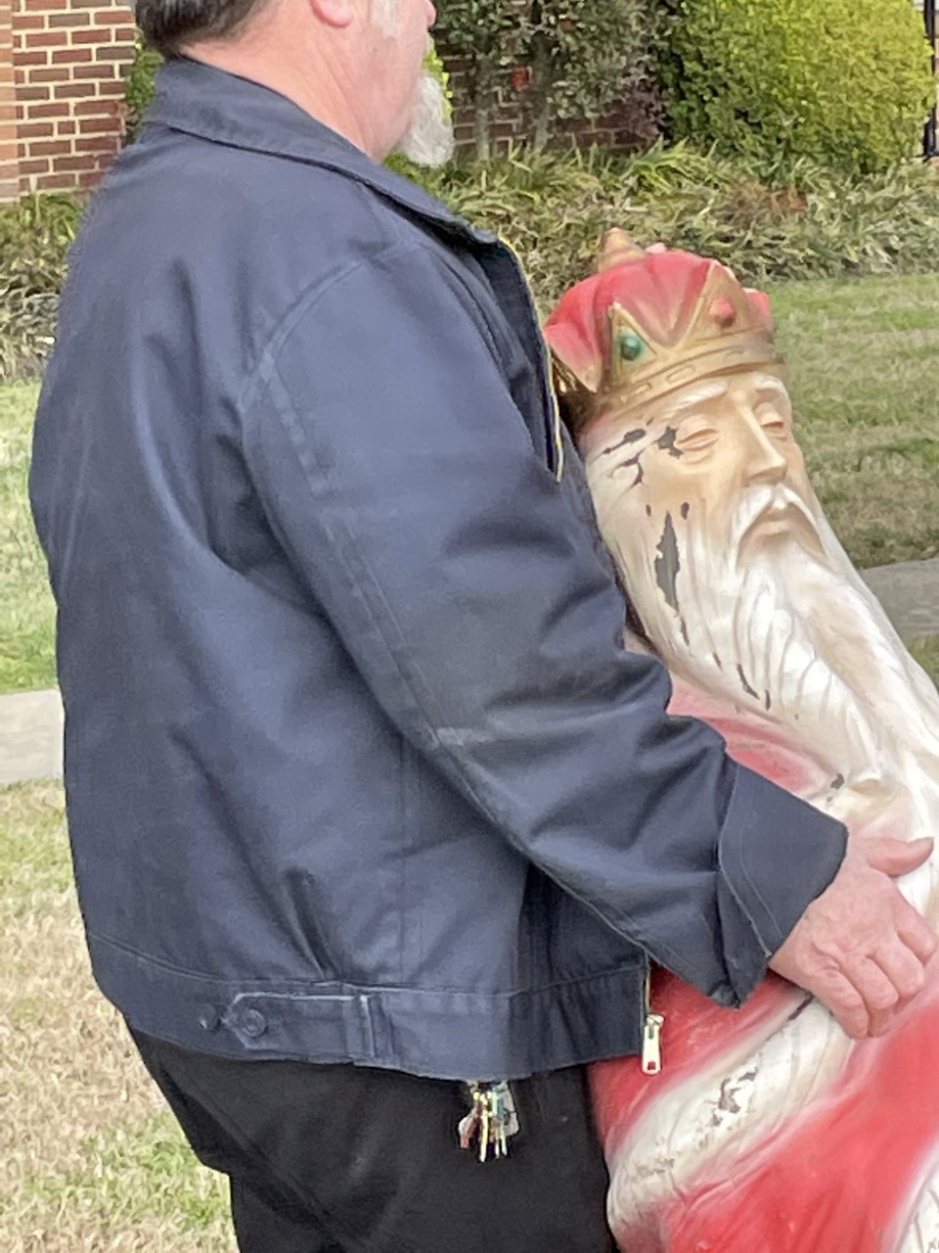

Slide 4
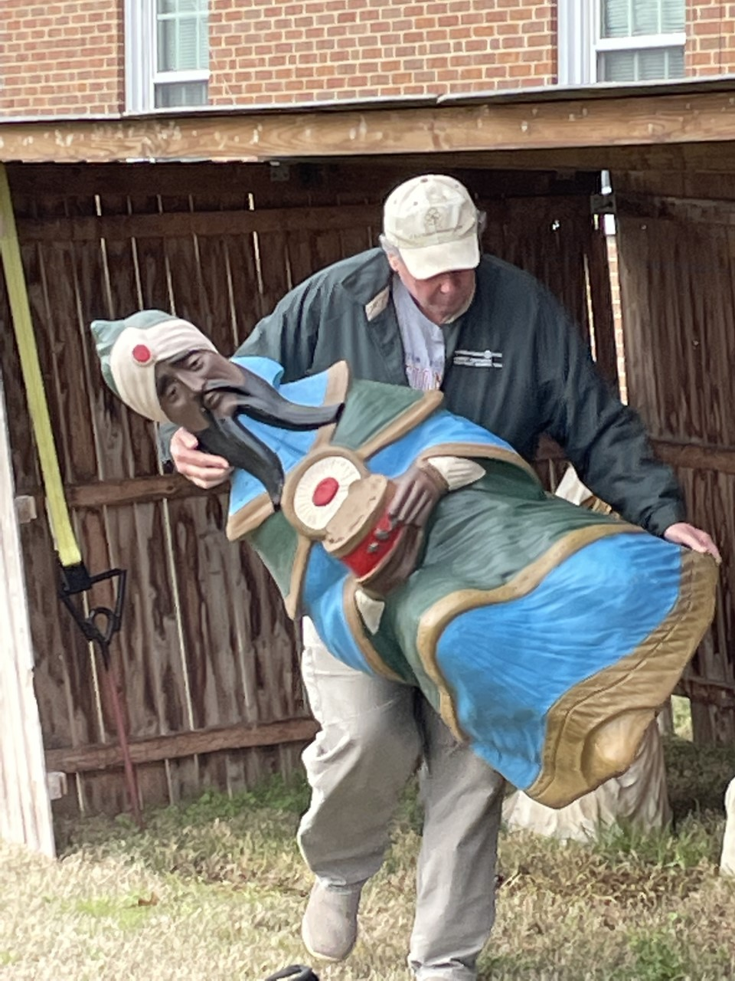

Slide 5
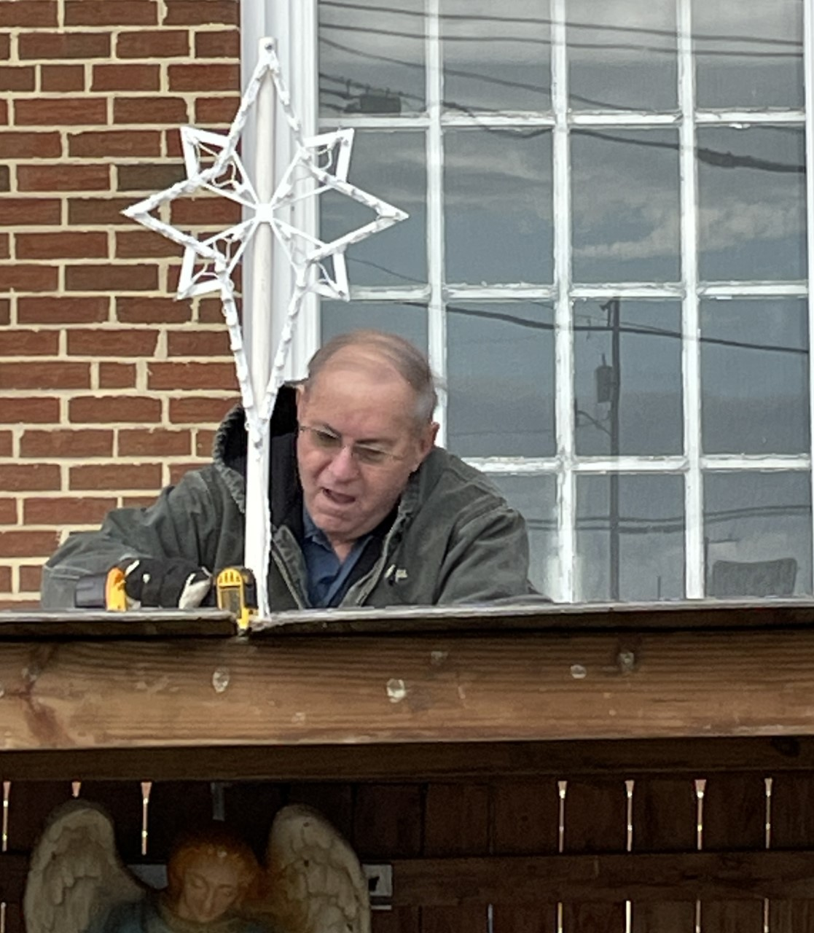

Slide 6
We celebrate our community

Slide 7
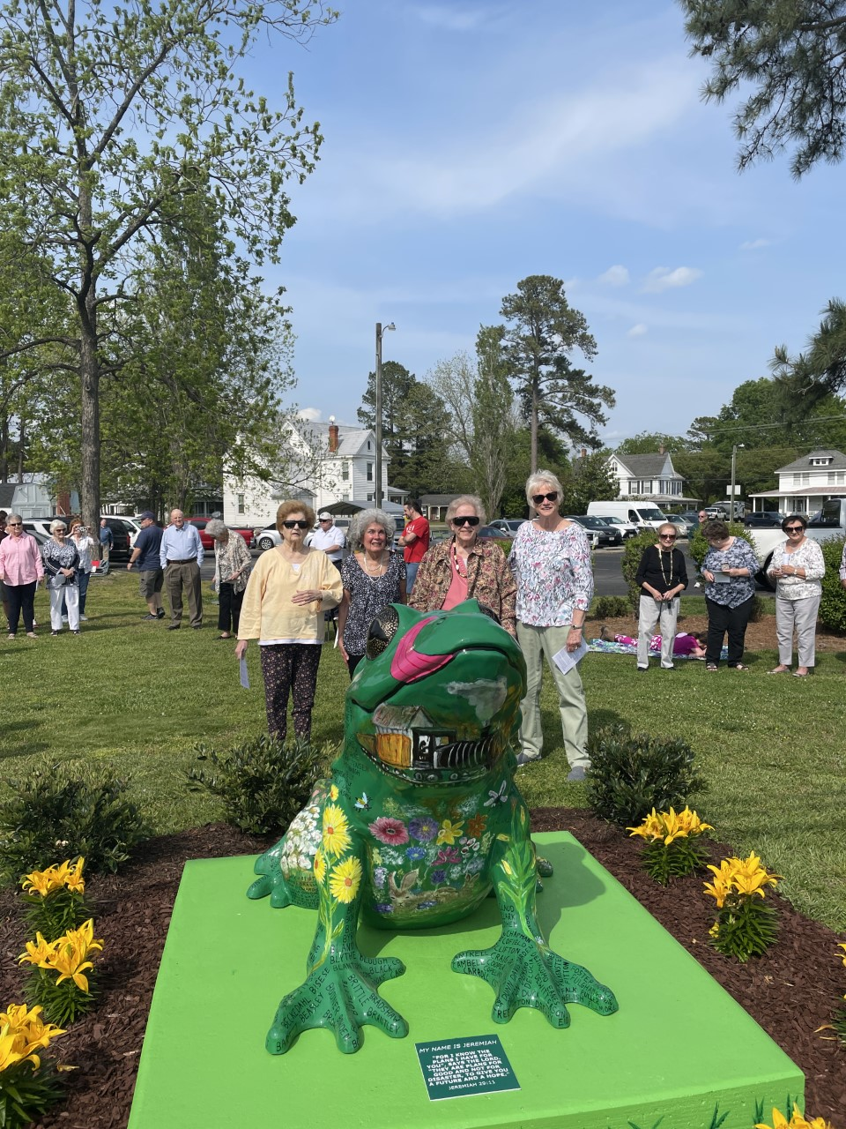

Slide 8
We study His Word

Slide 9
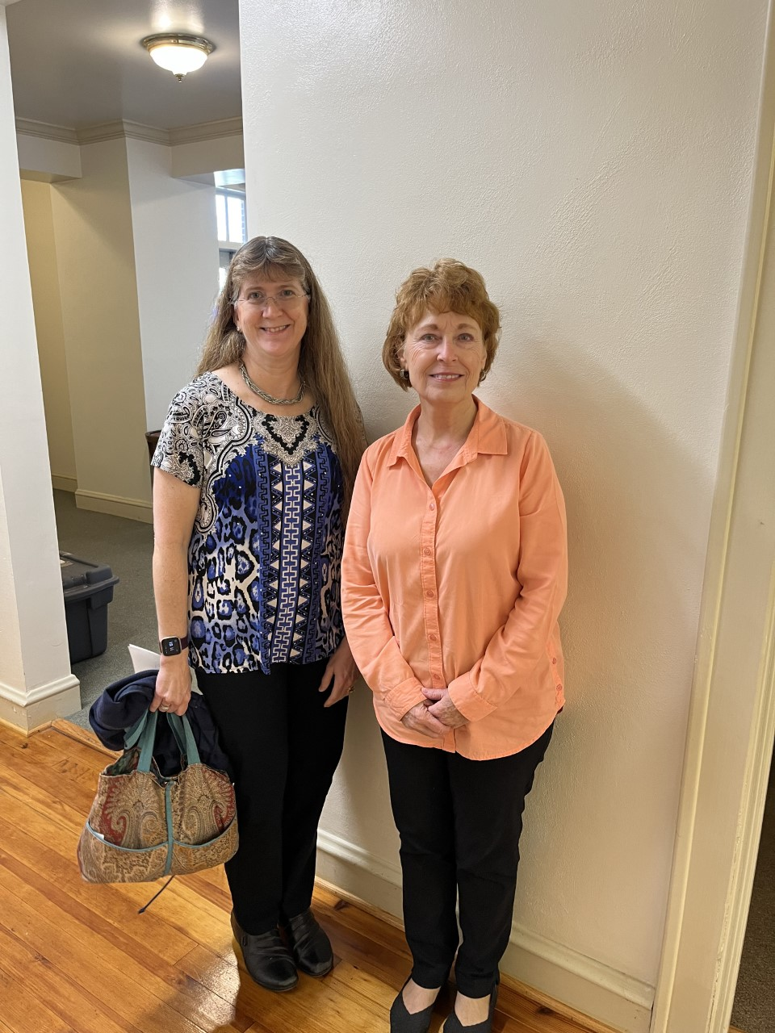

Slide 10
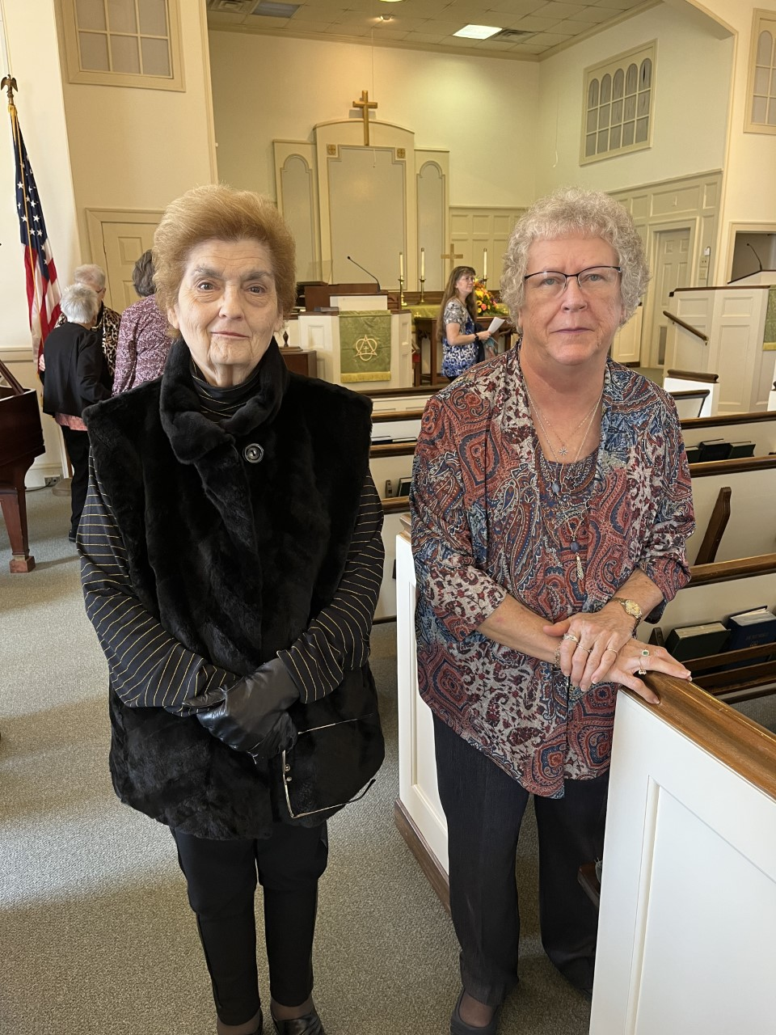

Slide 11
We serve others for Him

Slide 12
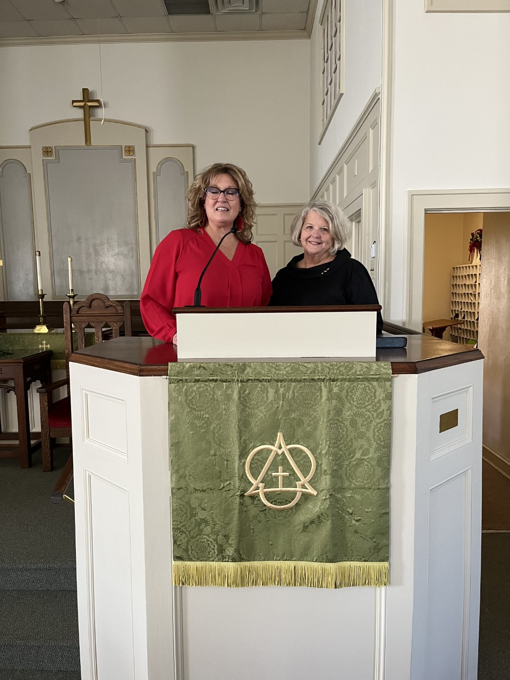

Slide 13
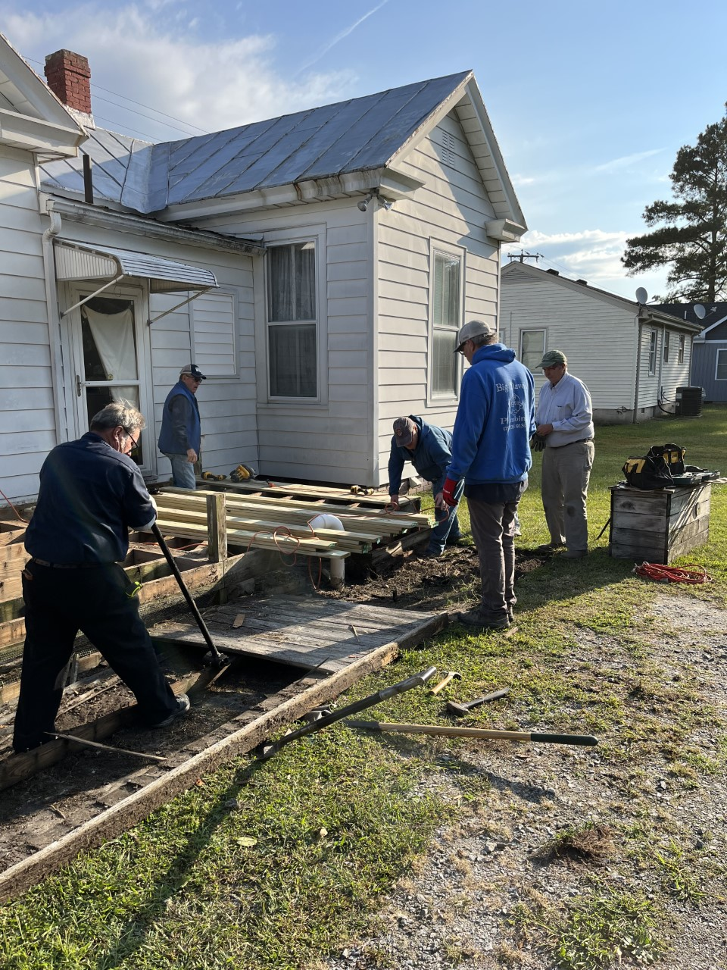

Slide 14
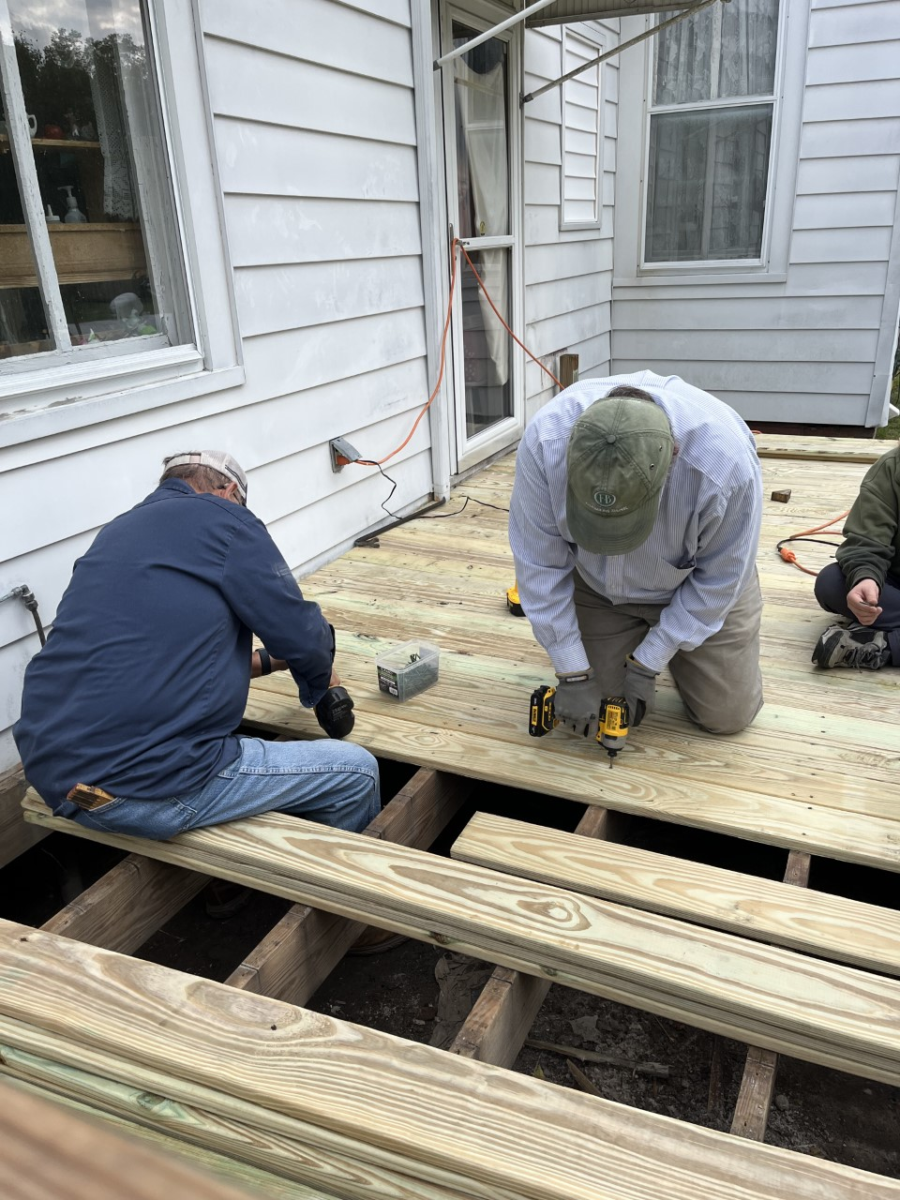

Slide 15
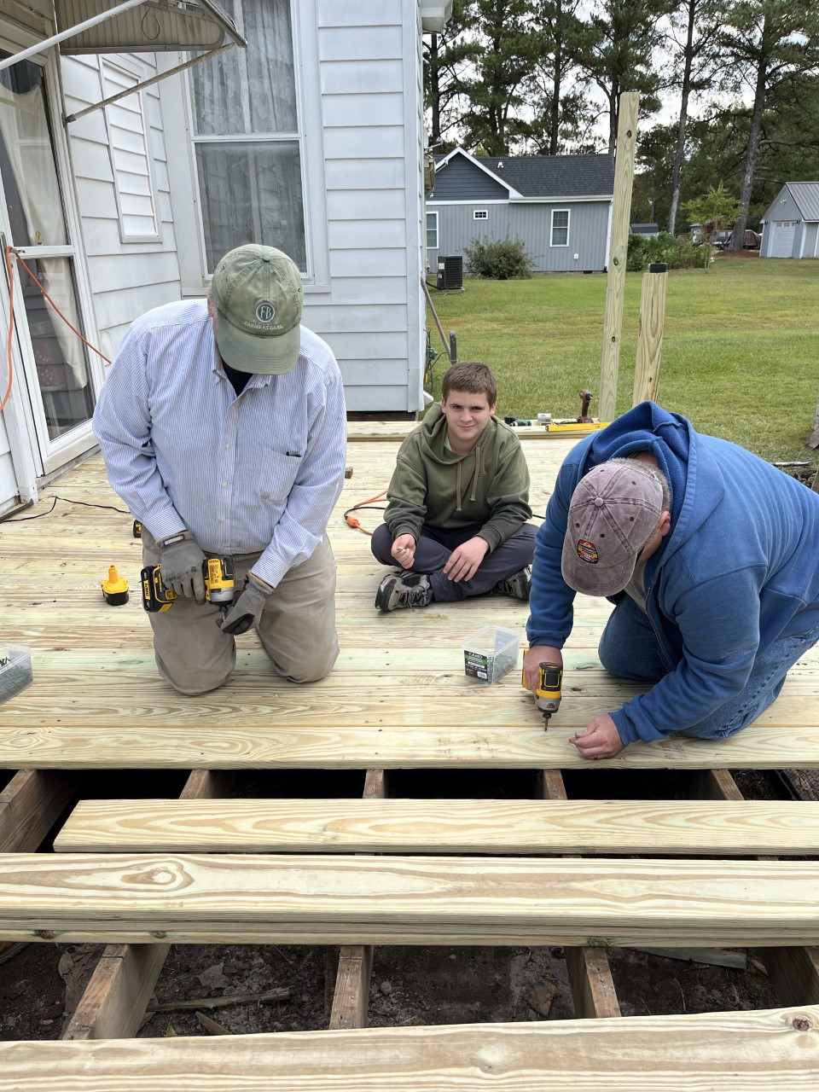

Slide 16
We celebrate growth in Him

Slide 17
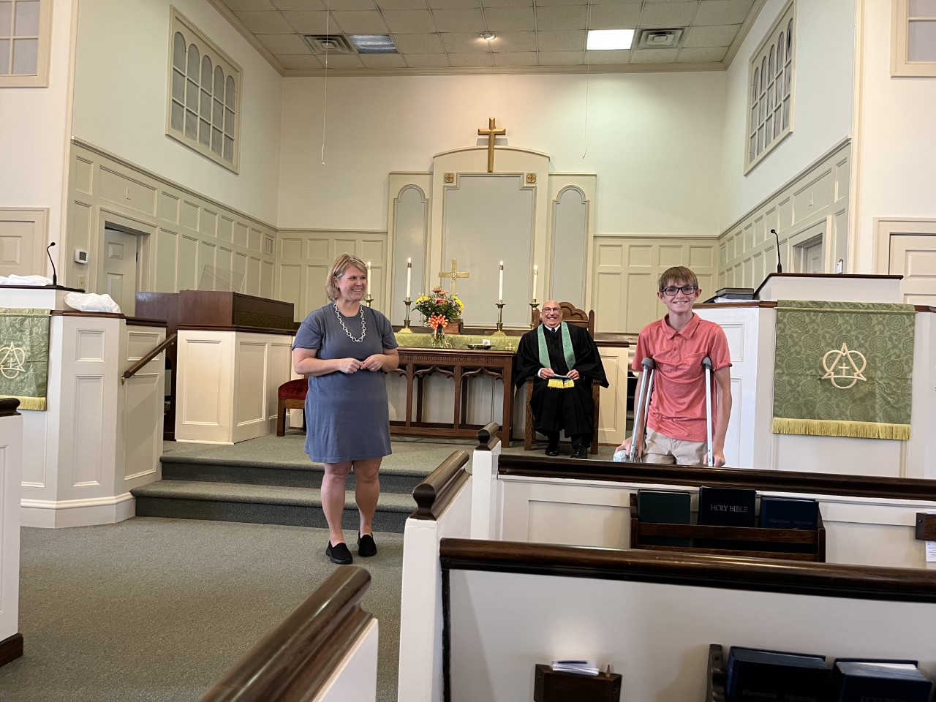

Slide 18
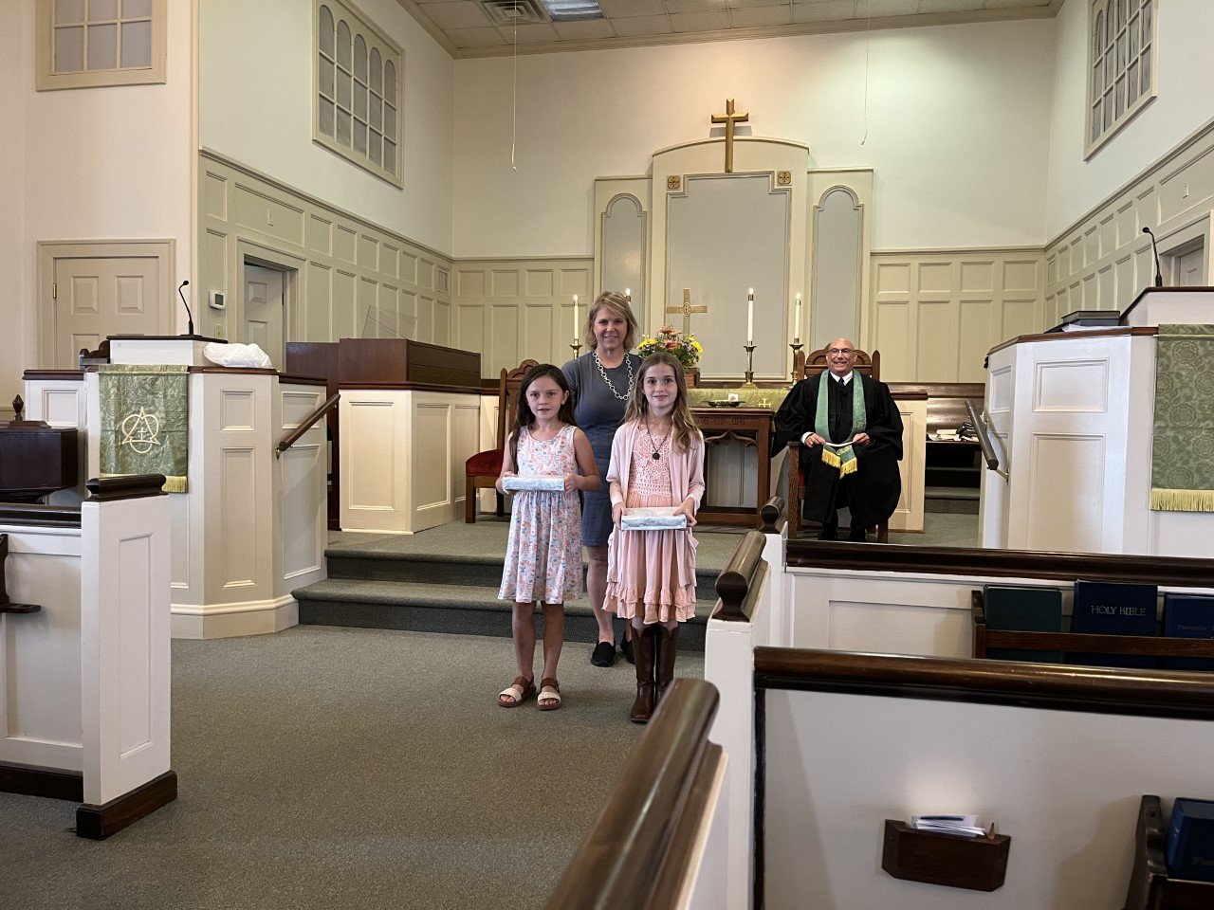

Slide 19
We fellowship together

Slide 20
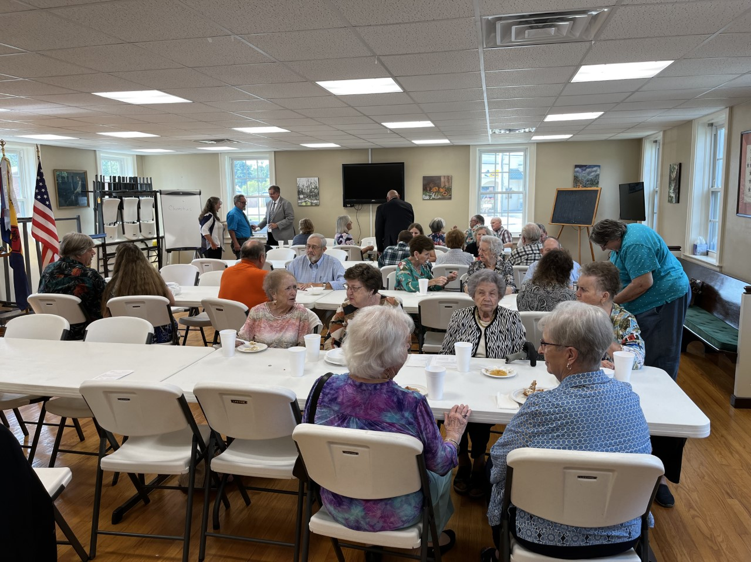

Slide 21
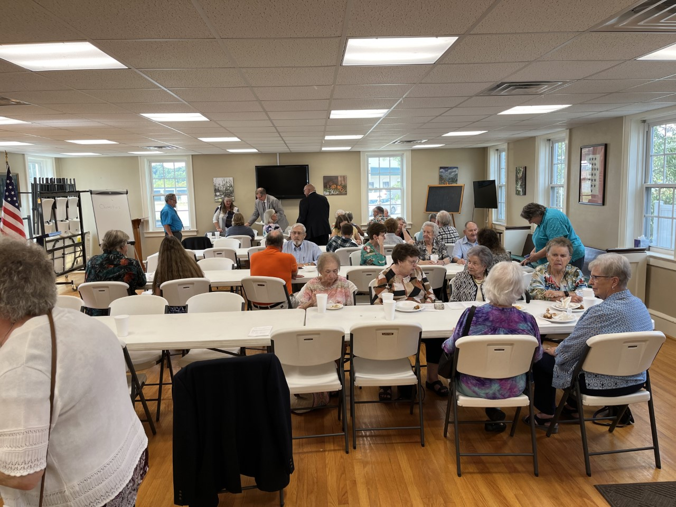

Slide 22
Our youth serve Him

Slide 23
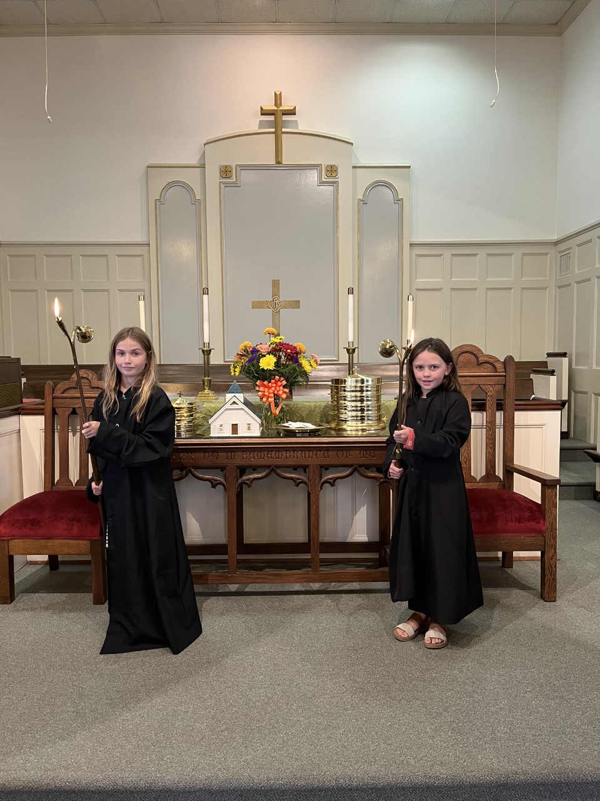

Slide 24
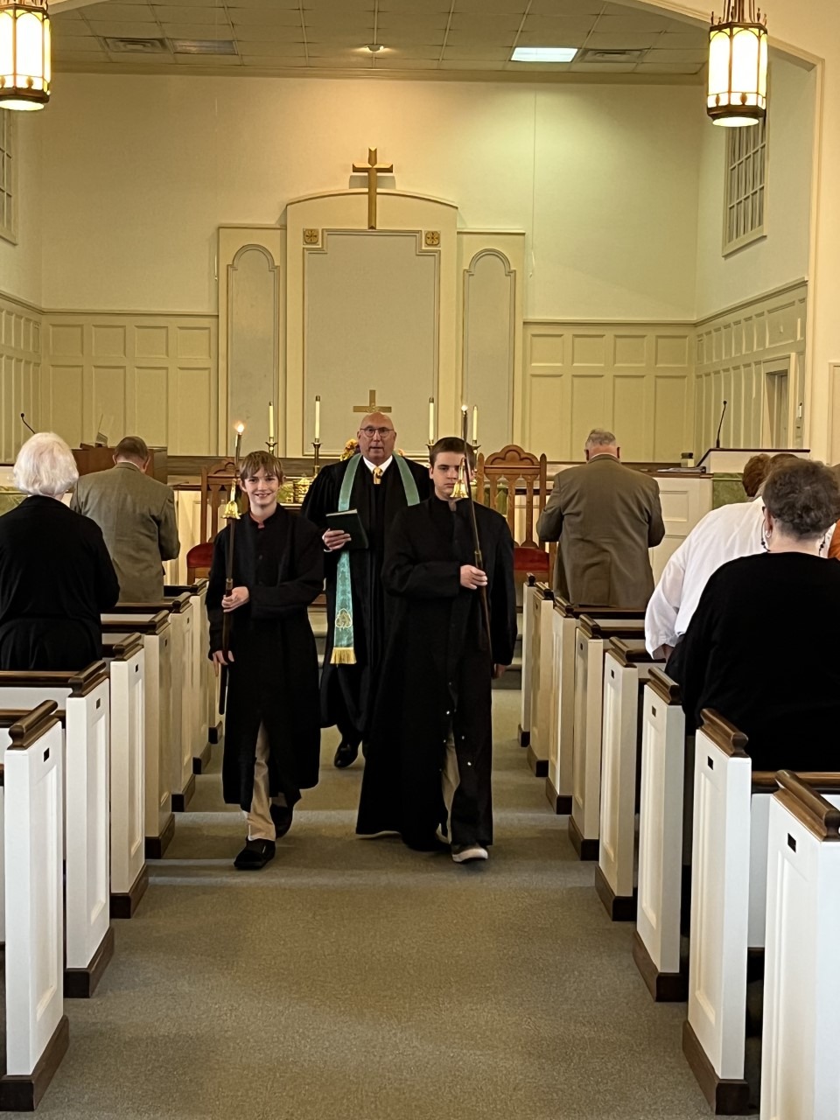

Slide 25
For whoever does the will of My Father who
is in heaven, he is My brother and sister and mother. Matthew 12:50

